Slide 1


EECS 545: Machine Learning Lecture 1. Introduction
Jake Abernethy
1/6/2015
Notes:
25 seconds
Thank you for the generous introduction.
I am Honglak Lee from Stanford,
and it’s my great pleasure to be here and I am very excited to talk about my research on unsupervised feature learning.
This is the work with my advisor Andrew Ng and many other people at Stanford

Slide 2
My First Big Question
What are so many of you people doing in this class room?
No really…
I had to fight to get this room to fit all you people.

Slide 3
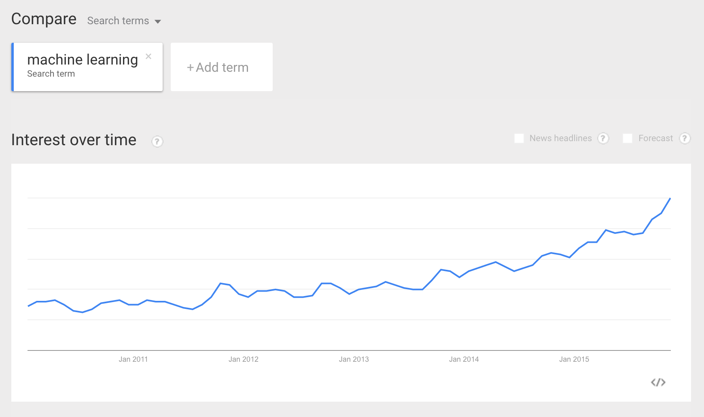
Machine Learning on Google Trends

Slide 4
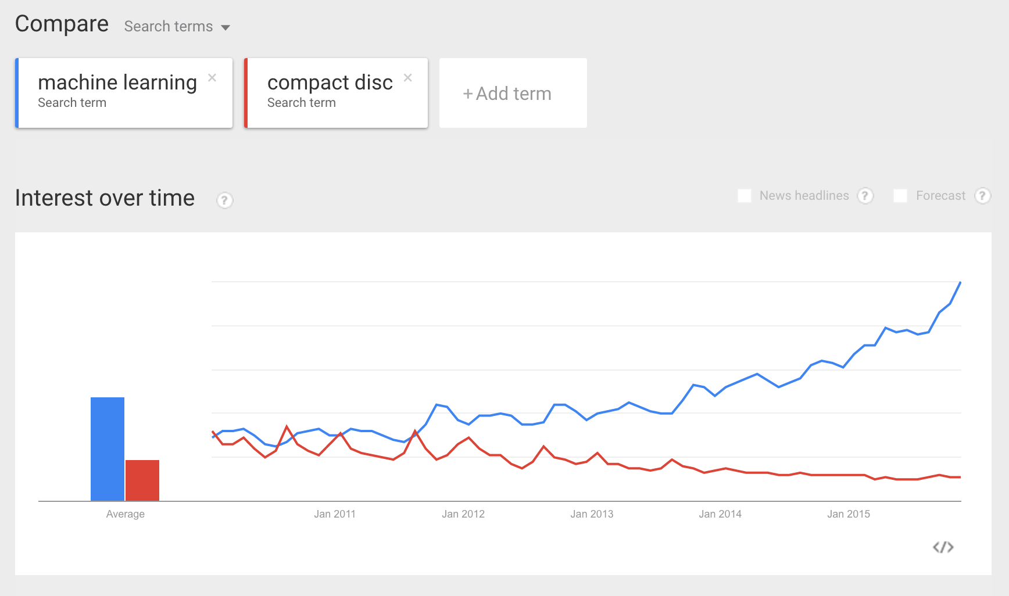
Machine Learning on Google Trends

Slide 5
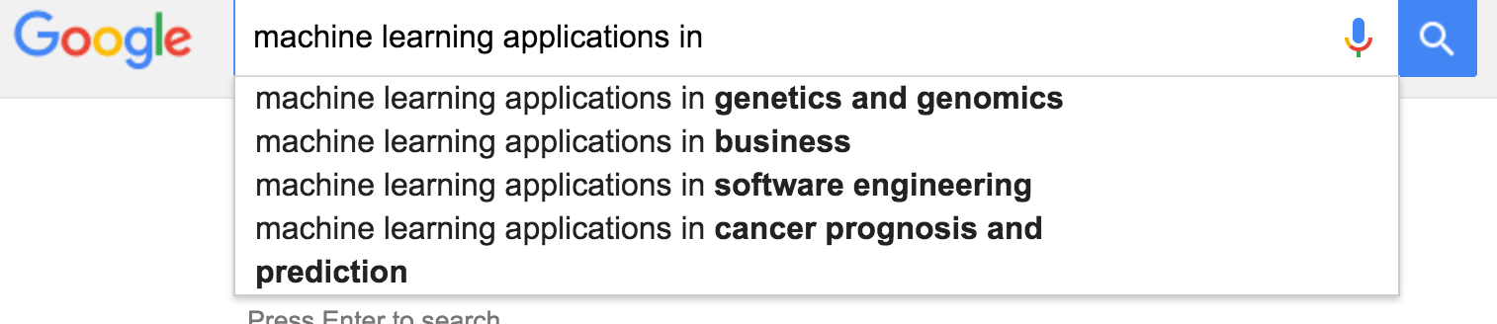
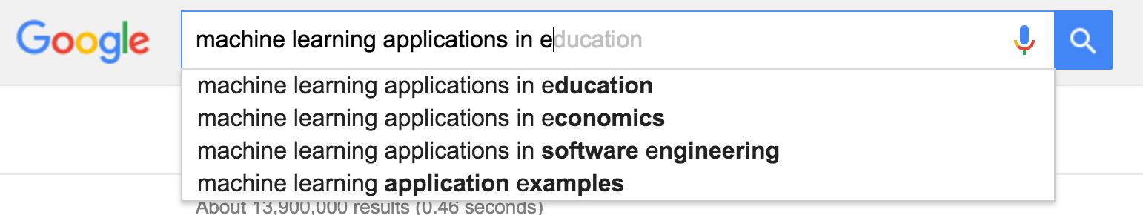
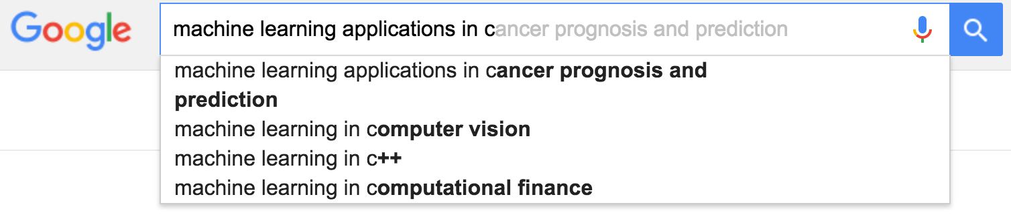
ML ➔ Lots of Applications

Slide 6
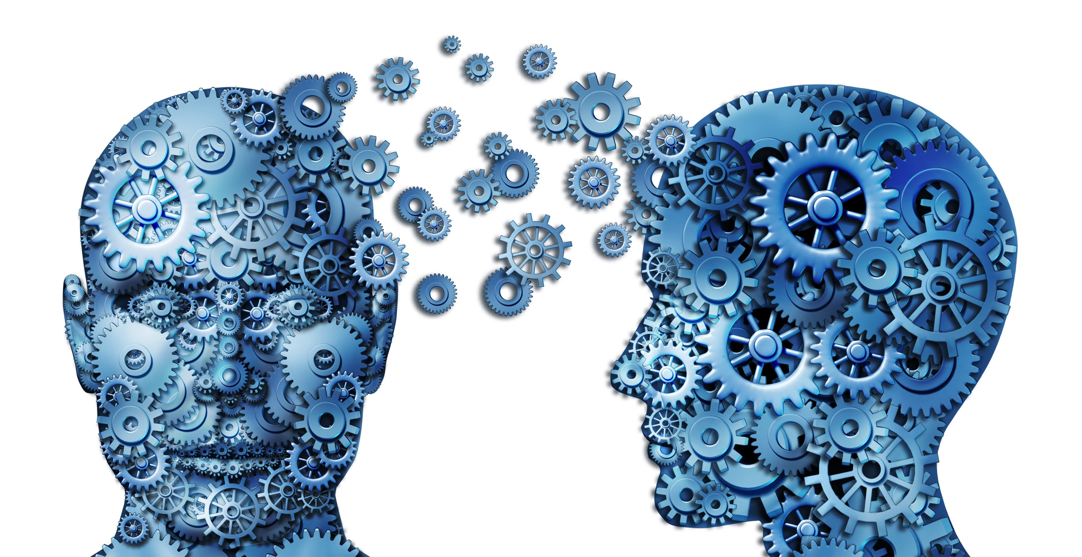
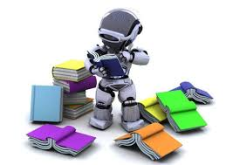

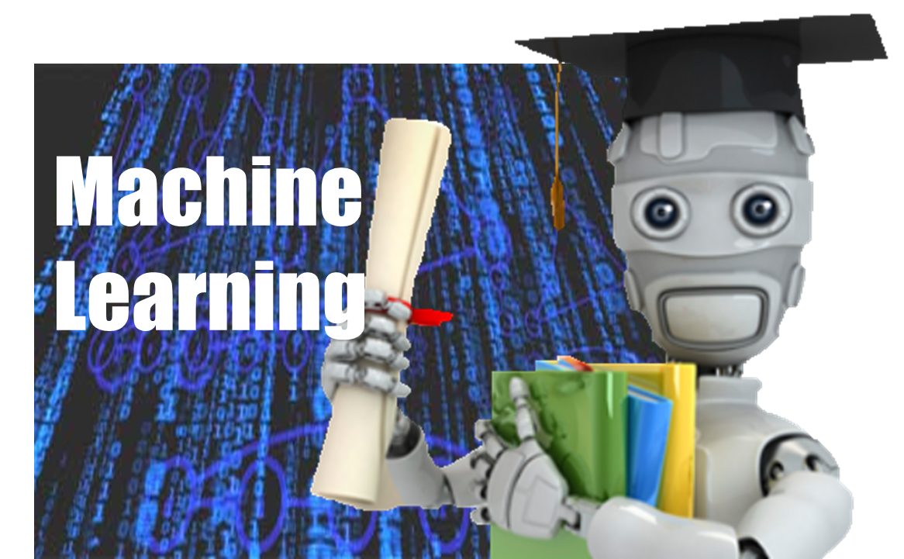
Machine Learning, according to Google Image Search

Slide 7
Where do you people come from?

Slide 8
What level are you people?

Slide 9
Outline
Administrative
What is machine learning?
Notes:
11:00
41 seconds
c
And here is the outline of the talk.
First I’ll talk about the motivating examples,
and then present what might be underlying principles or intuitions for learning useful low-level feature representations.
Then I will talk about learning hierarchical, sparse feature representations, and finally I will present scalable algorithms that can be applied to challenging real world data. I will also talk about my current and future research.

Slide 10
Teaching staff
Instructor: Jacob Abernethy
Email: jabernet@umich.edu
Office: CSE 3765
Office hour: Tuesdays 9:30am-12pm
Graduate Student Instructor:
David Ke Hong – kehong@umich.edu
Daniel Lejeune – dlejeune@umich.edu
Changhan Wang - wangchh@umich.edu
(IA) Benjamin Bray – benrbray@umich.edu
Will hold review sessions on background materials (linear algebra, probability, Python, etc.)
For all questions, please use Piazza:
http://piazza.com/umich/winter2016/eecs545
Notes:
11:00
41 seconds
c
And here is the outline of the talk.
First I’ll talk about the motivating examples,
and then present what might be underlying principles or intuitions for learning useful low-level feature representations.
Then I will talk about learning hierarchical, sparse feature representations, and finally I will present scalable algorithms that can be applied to challenging real world data. I will also talk about my current and future research.

Slide 11
About this course
Graduate-level introduction of machine learning
Provide foundations of machine learning
Mathematical derivation, Implementation of the algorithms, Applications
Topics
supervised learning
unsupervised learning
Kernel methods
Graphical models
Various advanced topics (TBD):learning theory, sparsity and feature selection, Bayesian techniques, ensemble methods, deep learning, multi-armed bandits

Slide 12
About this course
Cover practical applications of machine learning
computer vision, data mining, speech recognition, text processing, bioinformatics, and robot perception and control
Our goal is to help you to
Understand fundamentals of machine learning
Learn technical details of ML algorithms
Learn how to implement some important algorithms
Use machine learning algorithms for your research and applications.

Slide 13
Text books
(main) Chris Bishop, “Pattern Recognition and Machine Learning”. Springer, 2007.
(optional) Hastie, Tibshrani, Friedman, “Elements of Statistical Learning”. Springer, 2010.
(available online) http://www-stat.stanford.edu/~tibs/ElemStatLearn/
(optional) Boyd and Vandenberghe, "Convex Optimization," Cambridge University Press, 2004.
(available online) http://www.stanford.edu/~boyd/cvxbook/
(optional) Mackay, “Information Theory, Inference, and Learning Algorithms”. Cambridge University Press. 2003.
(available online) http://www.inference.phy.cam.ac.uk/itprnn/book.pdf
Notes:
11:00
41 seconds
c
And here is the outline of the talk.
First I’ll talk about the motivating examples,
and then present what might be underlying principles or intuitions for learning useful low-level feature representations.
Then I will talk about learning hierarchical, sparse feature representations, and finally I will present scalable algorithms that can be applied to challenging real world data. I will also talk about my current and future research.

Slide 14
Prerequisites
EECS 492: Introduction to AI
(official requirement, but you can still take this course without completing 492)
Undergrad linear algebra (e.g., MATH 217, MATH 417)
Multivariate calculus
Undergrad probability and statistics (e.g., EECS 401)
Programming skills (equivalent to EECS 280, EECS 281, experience in Python or Matlab)
Nontrivial level of programming is required.
NOTE: If you have not taken at least two of linear algebra, multivariate calculus, and probability courses, it is strongly recommended that you finish them first before taking this course.
Notes:
11:00
41 seconds
c
And here is the outline of the talk.
First I’ll talk about the motivating examples,
and then present what might be underlying principles or intuitions for learning useful low-level feature representations.
Then I will talk about learning hierarchical, sparse feature representations, and finally I will present scalable algorithms that can be applied to challenging real world data. I will also talk about my current and future research.

Slide 15
Grading policy
Homework: 40% (6 HWs, lowest dropped)
Midterm: 25%
Final Exam: 25%
Participation/Quizzes: 10%
Some options for extra credit:
Scribing
HW Solutions
OPTIONAL Final Project (Details to come.)
Notes:
11:00
41 seconds
c
And here is the outline of the talk.
First I’ll talk about the motivating examples,
and then present what might be underlying principles or intuitions for learning useful low-level feature representations.
Then I will talk about learning hierarchical, sparse feature representations, and finally I will present scalable algorithms that can be applied to challenging real world data. I will also talk about my current and future research.

Slide 16
Homework
There will be 6 (bi-weekly) problem sets.
Goal: strengthen the understanding of the fundamental concepts, mathematical formulations, algorithms, and the applications.
The problem sets will also include programming assignments to implement algorithms covered in the class.
Homework #1 will be out next Monday (1/11) – due 1/25, 11pm.
Notes:
11:00
41 seconds
c
And here is the outline of the talk.
First I’ll talk about the motivating examples,
and then present what might be underlying principles or intuitions for learning useful low-level feature representations.
Then I will talk about learning hierarchical, sparse feature representations, and finally I will present scalable algorithms that can be applied to challenging real world data. I will also talk about my current and future research.

Slide 17
Language of Choice: Python
Python is a better language overall for data science, with modern libraries and excellent online tutorials for various tasks
We will utilize Python throughout the course, and we encourage you to do the same
GSIs will run Python help sessions and will provide fast answers on Piazza
Homeworks will be mostly language-independent, so we will permit use of Matlab

Slide 18
Study group
Form your study group early on!
Up to four people are allowed.
For homework, you may discuss between the study group members, but you should write your own solution independently.
In the homework submissions, you must put:
the names of other people you collaborated.
submission time.
Please start on homework early. (Warning: cramming does not work!)

Slide 19
Other Information
Review sessions
Will hold review sessions on background materials (linear algebra, probability, Python, etc.)
Canvas site posted soon!
No email policy! Use Piazza!
Piazza allows for private questions
Email your GSI if it’s too personal for Piazza
Email me if it’s too personal for your GSI

Slide 20
Any questions?

Slide 21
Outline
Administrative
What is machine learning?
Notes:
11:00
41 seconds
c
And here is the outline of the talk.
First I’ll talk about the motivating examples,
and then present what might be underlying principles or intuitions for learning useful low-level feature representations.
Then I will talk about learning hierarchical, sparse feature representations, and finally I will present scalable algorithms that can be applied to challenging real world data. I will also talk about my current and future research.

Slide 22
Definition of Machine Learning
Formal definition (Mitchell 1997): A computer program A is said to learn from experience E with respect to some class of tasks T and performance measure P, if its performance at tasks in T, as measured by P, improves with experience E.

Slide 23
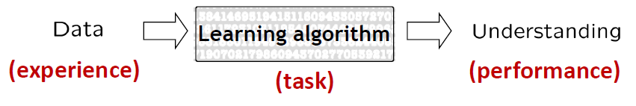
Informal definition
Algorithms that improve their prediction performance at some task with experience (or data).
Learning Algorithm

Slide 24
Example: Spam email filtering
“A computer program is said to learn from experience E with respect to some task T and some performance measure P, if its performance on T, as measured by P, improves with experience E.”
Suppose your email program watches which emails you do or do not mark as spam, and based on that learns how to better filter spam.
Task:
Classifying emails as spam or not spam.
Experience:
Watching you label emails as spam or not spam.
Performance measure
The number (or fraction) of emails (disjoint from the training emails) correctly classified as spam/not spam.
Slide credit: Andrew Ng

Slide 25
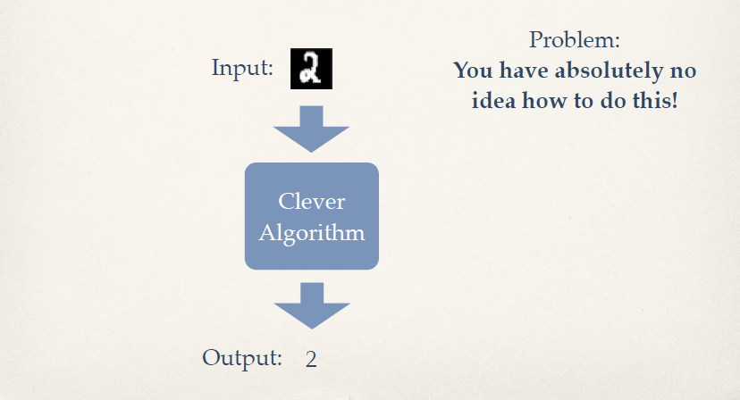
Example
Problem: Given an image of a handwritten digit, what digit is it?
Slide credit: Kilian Weinberger

Slide 26
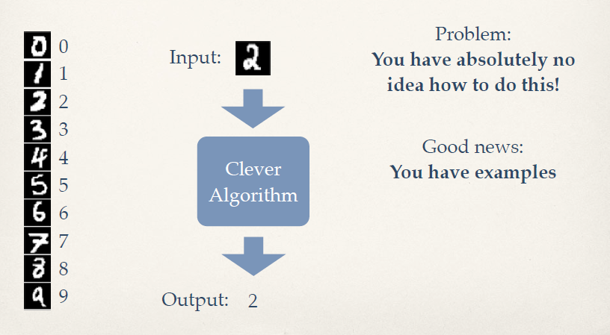
Example
Problem: Given an image of a handwritten digit, what digit is it?
Slide credit: Kilian Weinberger

Slide 27
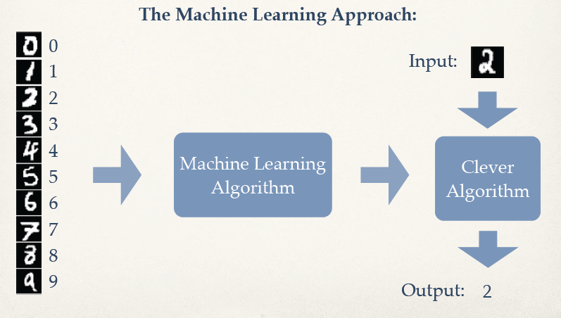
Example
Problem: Given an image of a handwritten digit, what digit is it?
Slide credit: Kilian Weinberger

Slide 28
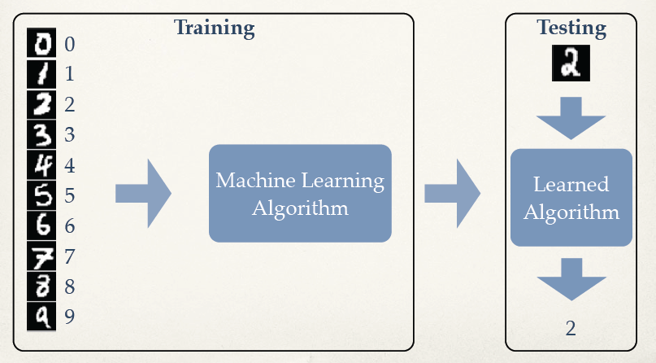
Example
Problem: Given an image of a handwritten digit, what digit is it?
Slide credit: Kilian Weinberger

Slide 29
Machine Learning Tasks
Supervised Learning
Classification
Regression
Unsupervised Learning
Clustering
Density estimation
Embedding / Dimensionality reduction
Reinforcement Learning
Learning to act (e.g., robot control, decision making, etc.)

Slide 30
Supervised Learning
Goal:
Given data X in feature space and the labels Y
Learn to predict Y from X
Labels could be discrete or continuous
Discrete labels: classification
Continuous labels: regression

Slide 31
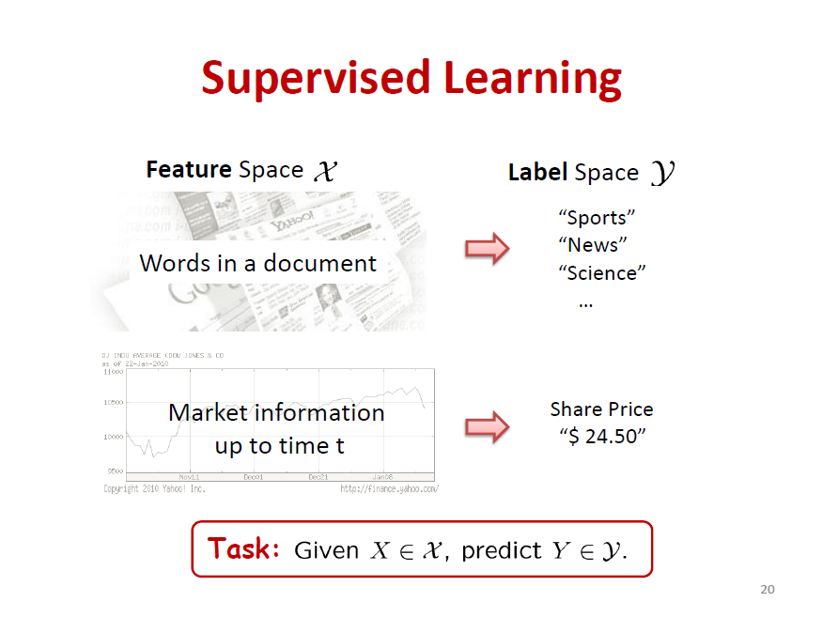
Supervised Learning
Slide credit: Aarti Singh

Slide 32
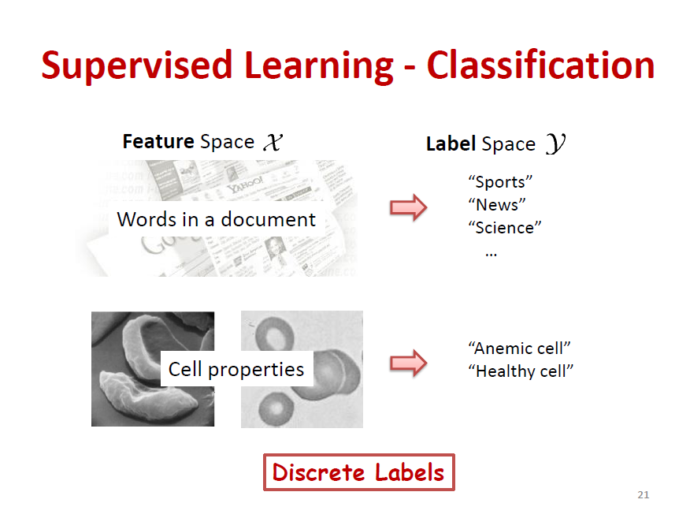
Supervised Learning - Classification
Slide credit: Aarti Singh

Slide 33
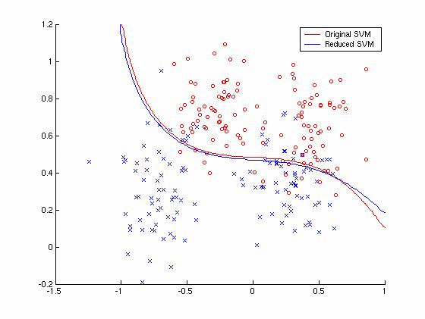
Supervised Learning - Classification
Smoking
Red: Positive label (e.g., lung cancer)
Blue: Negative label (e.g., normal)
Age
“Learning decision boundaries”

Slide 34
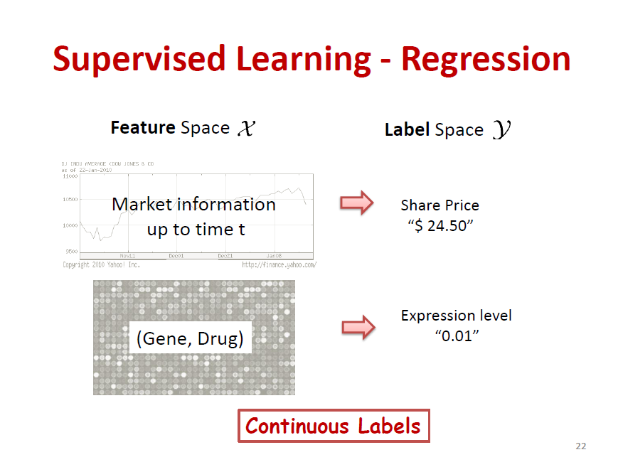
Supervised Learning - Regression
Slide credit: Aarti Singh

Slide 35
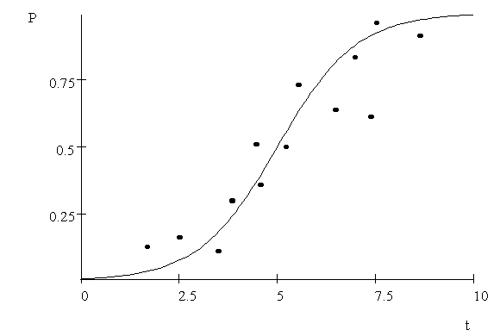
Supervised Learning - Regression
Label
(output)
Input feature
“Learning regression function f(X)”

Slide 36
Unsupervised Learning
Goal:
Given data X without any labels
Learn the structures of the data
Clustering
Probability distribution (density)
Embedding & neighborhood relations
“Learning without teacher”

Slide 37
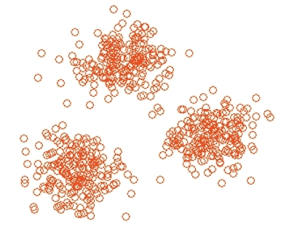
Unsupervised Learning – Clustering
“Grouping into similar examples”

Slide 38
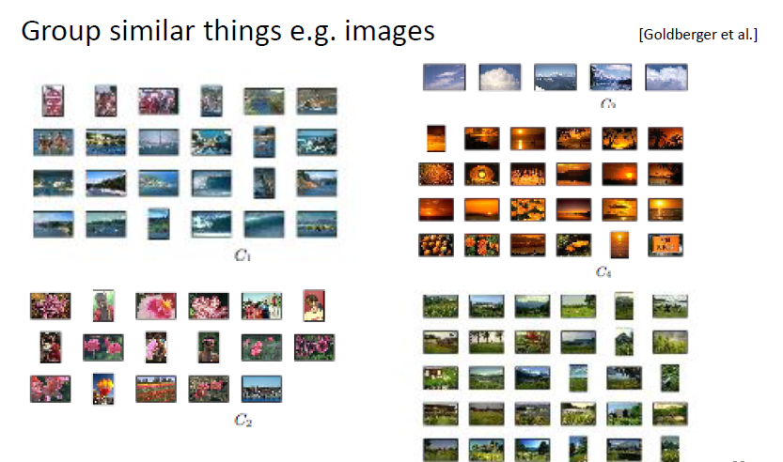
Unsupervised Learning – Clustering
“Grouping into similar examples”
Slide credit: Aarti Singh

Slide 39
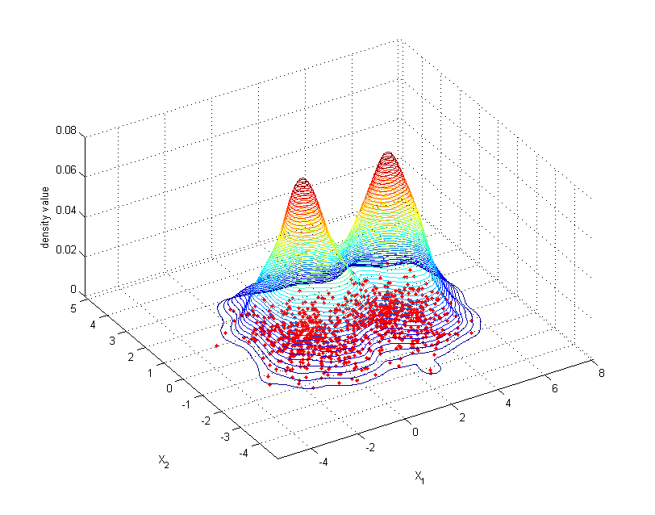
Unsupervised Learning – Density estimation
P(X1, X2)
“Probability”

Slide 40
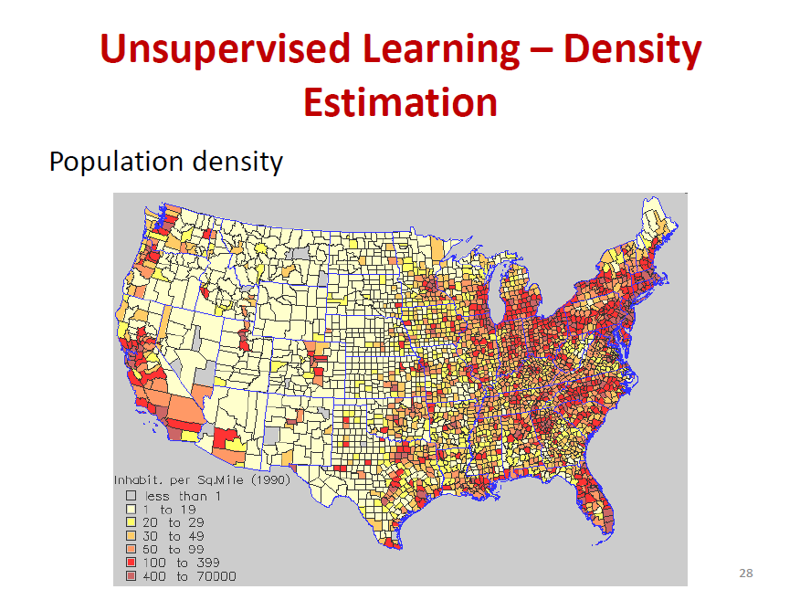
Unsupervised Learning – Density estimation
P(X1, X2)
“Probability”
Slide credit: Aarti Singh

Slide 41
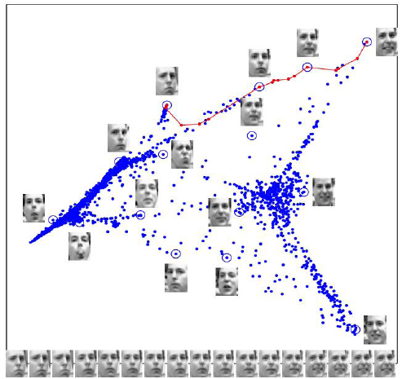
Unsupervised Learning-Embedding and Dimensionality reduction
E.g., Reducing pixel images (several thousand pixels) into low dimensional coordinates
[Saul and Roweis, 03]

Slide 42
Reinforcement Learning
Setting
Given sequence of states X and “rewards” (e.g., delayed labels)
Agent has to take actions A for each time step
Goal:
How to “learn to act” or “make decisions” to maximize the sum of future rewards
Example: Robot navigation task
Input: Dynamical environment + sensor input
Action: control signals
Rewards: time to reach goal without colliding with obstacles

Slide 43
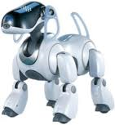
Reinforcement Learning – learning to control
Example: Robot walking
States: sensor inputs, joint angles
Action: servo commands for joints
Rewards:
1 for reaching the goal
-1 for falling down
0 otherwise
Goal: How can we provide
control inputs to maximize the
expected future rewards?

Slide 44
Feature representations

Slide 45
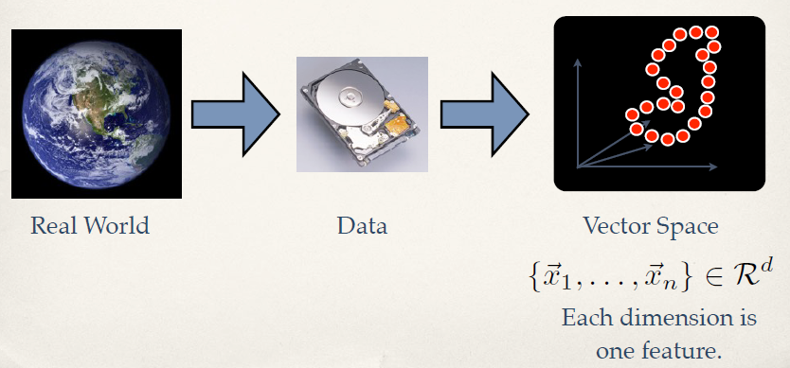
Feature Extraction
Represent data in terms of vectors.
Features are statistics or attributes that describe the data.
Slide credit: Kilian Weinberger

Slide 46
Examples of features: Housing data
Given statistics about houses in a local area, predict median value of homes.
#ROOM: average number of rooms per dwelling
AREA: average area of house in square foot
AGE: proportion of owner-occupied units built prior to 1940
CRIME: per capita crime rate by town
RESZONE: proportion of residential land zoned for lots over 25,000 sq.ft.
INDUS: proportion of non-retail business acres per town
NOX: nitric oxides concentration (parts per 10 million)
…..
Label: Median value of owner-occupied homes

Slide 47
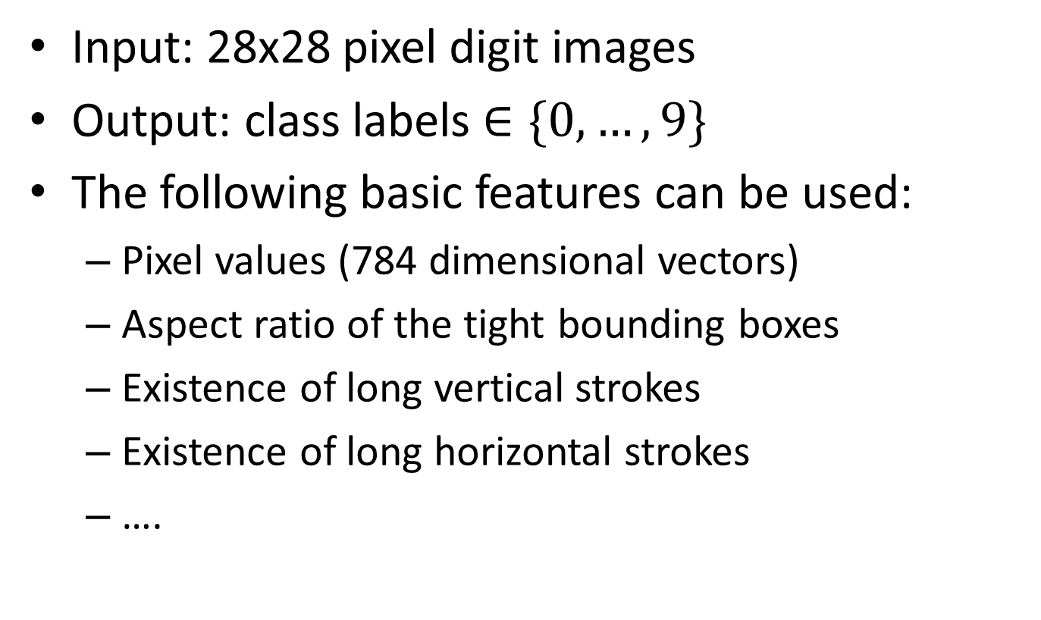
Examples of features: Recognizing handwritten-digits
Input: 28x28 pixel digit images
Output: class labels $∈\{0,…, 9\}$
The following basic features can be used:
Pixel values (784 dimensional vectors)
Aspect ratio of the tight bounding boxes
Existence of long vertical strokes
Existence of long horizontal strokes
….

Slide 48
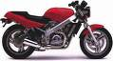
Learning pipeline
pixel 1
Learning
algorithm
pixel 2
Input
Motorbikes
Input space
“Non”-Motorbikes
pixel 2
pixel 1
Notes:
5:00
To introduce our method, consider a fundamental problem in machine learning.
Suppose that we are given an image of motorcycles as an input image.
The input might be the values of all pixel intensities in an image.
In such cases, then the points in the original input space may not be well seperated.
However, if we have some better feature representation, the examples can be better seperated in the feature space.
4:30
To introduce our method, consider a fundamental problem in machine learning.
We are given some inputs that we need to classify (say into two classes, denoted by crosses and minuses).
The input might be the values of all pixel intensities in an image like this.
The problem is that in the input space, it might be very difficult to learn a good classifier because the classes are mixed together.
To solve this problem, we could try to find functions of the inputs, or features, such that the classes are now well separated. Once we have such features, it is easy to apply your favorite supervised learner to learn a classifier.
[[In this way of looking at learning, all the magic must happen in the construction of the feature space.]]
What is unclear is how you would find such features.
Take the example of image classification.
More pragmatically,

Slide 49
Learning pipeline
handle
Feature representation
Learning
algorithm
wheel
Input
Motorbikes
Input space
Feature space
“Non”-Motorbikes
“handle”
pixel 2
pixel 1
“wheel”
Notes:
6:15
To introduce our method, consider a fundamental problem in machine learning.
Suppose that we are given an image of motorcycles as an input image.
The input might be the values of all pixel intensities in an image.
In such cases, then the points in the original input space may not be well seperated.
However, if we have some better feature representation, the examples can be better seperated in the feature space.
4:30
To introduce our method, consider a fundamental problem in machine learning.
We are given some inputs that we need to classify (say into two classes, denoted by crosses and minuses).
The input might be the values of all pixel intensities in an image like this.
The problem is that in the input space, it might be very difficult to learn a good classifier because the classes are mixed together.
To solve this problem, we could try to find functions of the inputs, or features, such that the classes are now well separated. Once we have such features, it is easy to apply your favorite supervised learner to learn a classifier.
[[In this way of looking at learning, all the magic must happen in the construction of the feature space.]]
What is unclear is how you would find such features.
Take the example of image classification.
More pragmatically,

Slide 50

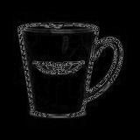
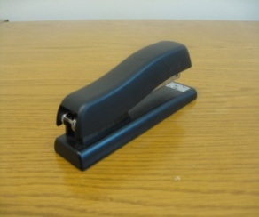


Computer Perception Pipeline
Input data
Feature representation
Learning
algorithm
Image
Low-level features
Grasp point
Object detection
Image
Low-level
vision features
Recognition
Notes:
7:30

Slide 51
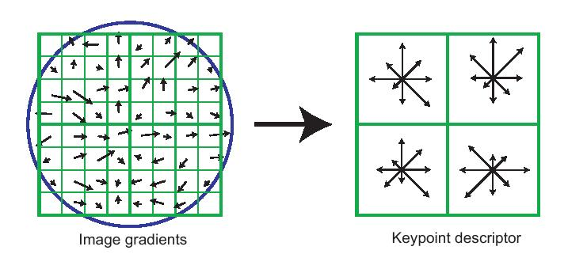
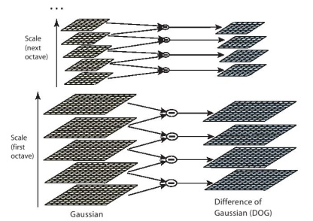
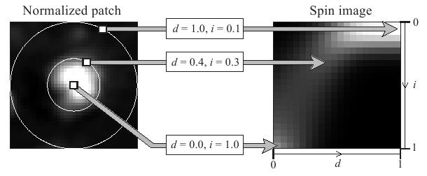
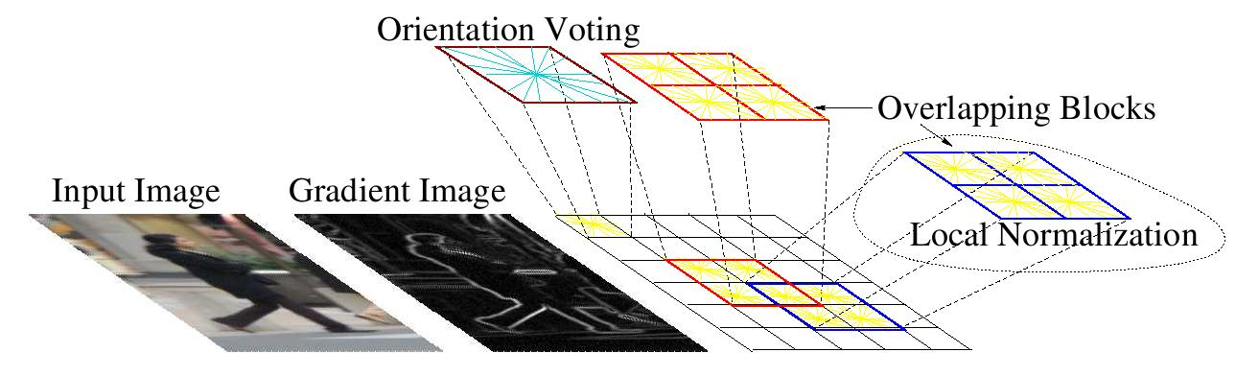
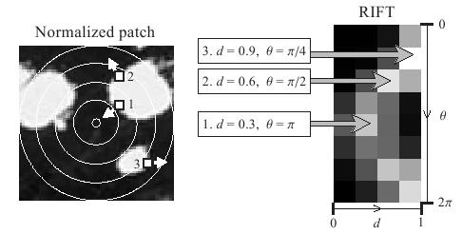
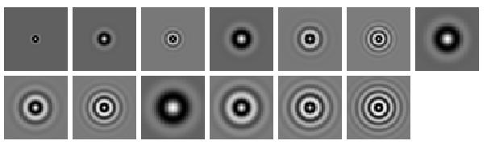
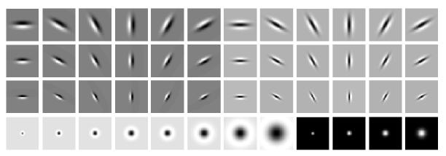
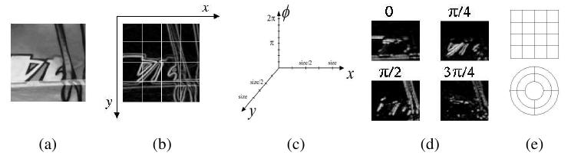
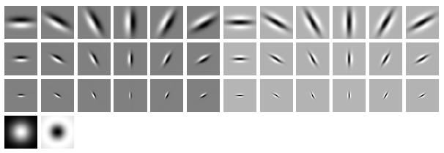
Computer vision features
SIFT
Spin image
HoG
RIFT
Textons
GLOH
Notes:
8:25
In the field of computer vision, to address the issue that I just mentioned, there had been many features representations that have been developed.
For example one of the most famous feature is RSS and all and many others and it these features give the really good results and they are widely used in computer vision with one however one potential problem is that it is not very trivial to come up with the feature presentation in other words you need to be experts in the in this computer vision domain and also you need to spend a fair amount of times for example maybe weeks or month or even give them a few years to to settle down with a good future representation the goal of my research is to automate the process of feature learning so that we don’t have to rely on these did not to rely on this manual feature engineering.

Slide 52
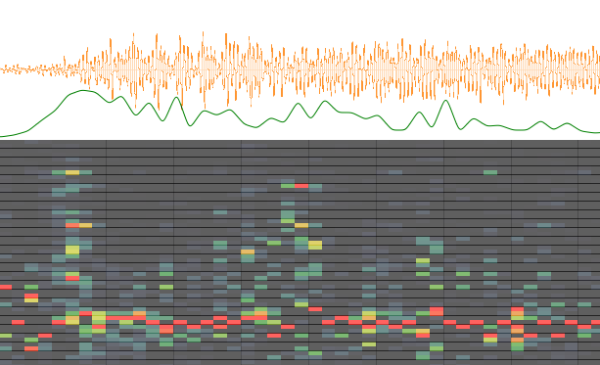
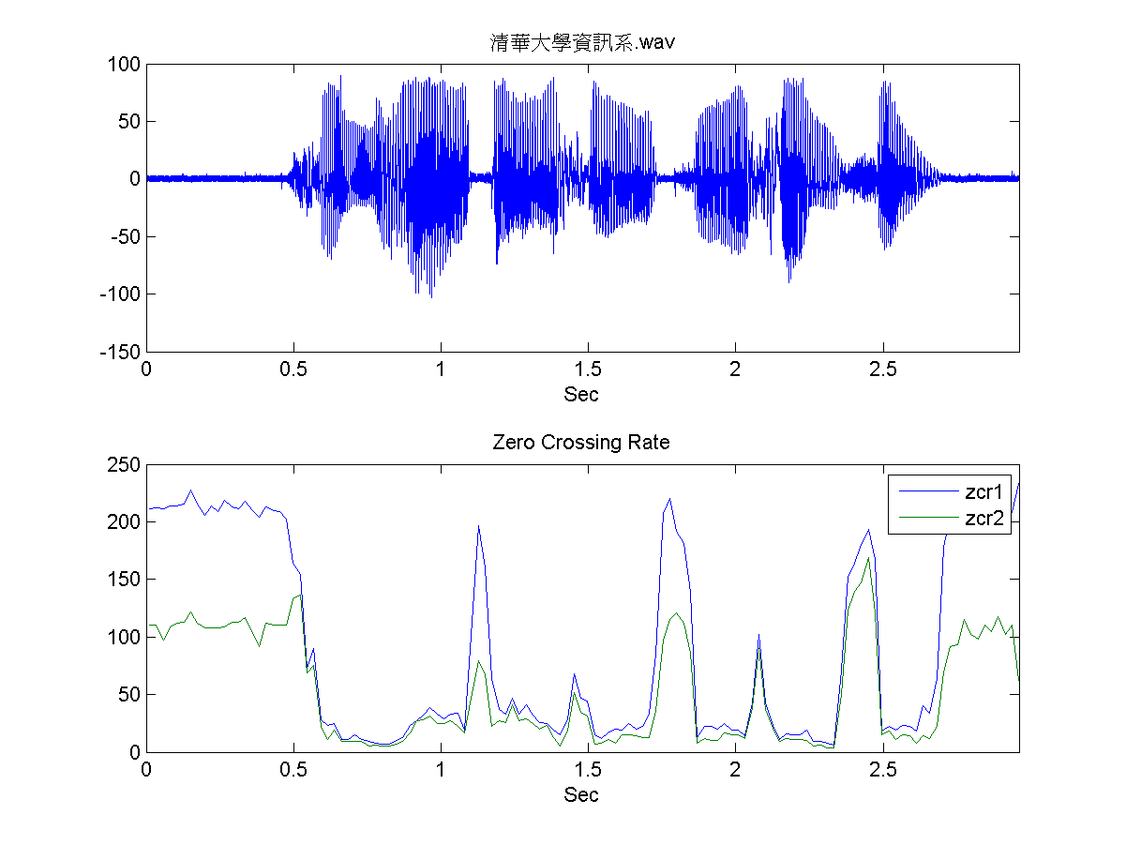
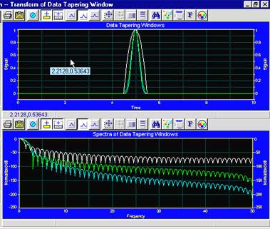
Audio features
Spectrogram
MFCC
Flux
ZCR
Rolloff
Notes:
9:00

Slide 53
Learning Features
Most state-of-the-art machine learning systems require careful hand-crafted features.
However, “learning features” by machine learning has emerged as a very active research recently.
“Unsupervised Feature Learning”

Slide 54
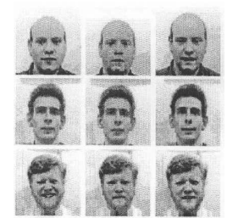
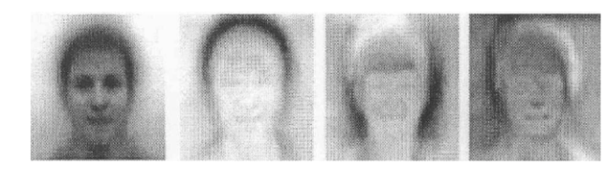
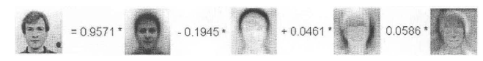
Constructing features via learning
Example: Eigenfaces
Training face images
Learned PCA bases
Test example
Images from www.cse.unr.edu/~bebis/CS485/Lectures/Eigenfaces.ppt
Notes:
11:30

Slide 55
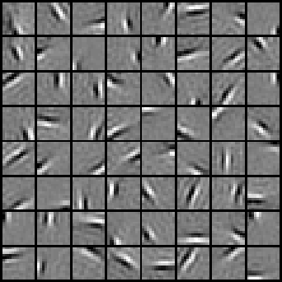







Learning features via sparse coding
Natural Images
Learned bases: “Edges”
Test example
~ 0.8 * + 0.3 * + 0.5 *
x ~ 0.8 * b₃₆ + 0.3 * b₄₂ + 0.5 * b₆₅
[0, 0, …, 0, 0.8, 0, …, 0, 0.3, 0, …, 0, 0.5, …]
= coefficients (feature representation)
Compact & easily
interpretable
Motivation?
Salient features, Compact representation
Notes:
13:00
End: “So, once we have learnt such basis vectors, we are ready to construct features for other the labeled data.”

Slide 56
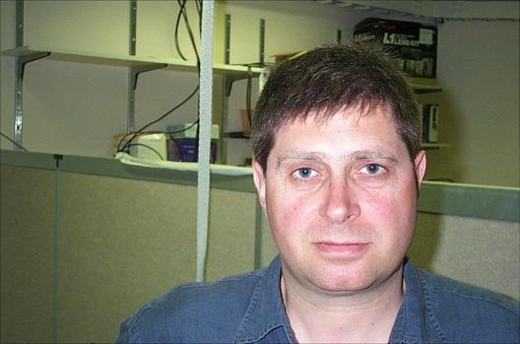

Learning hierarchy of features
Learn high-level “structures” from data.
Use these features for ML tasks.
Feature representation
Input data
3rd layer
“Objects”
2nd layer
“Object parts”
1st layer
“Edges”
Pixels

Slide 57
ML applications

Slide 58

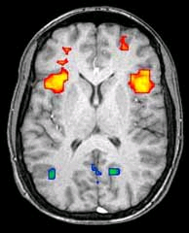
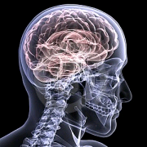

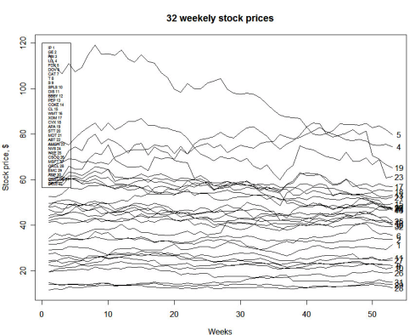
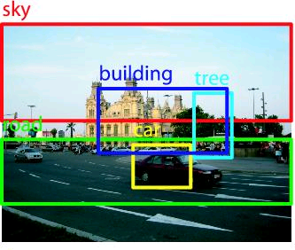


Examples of ML applications
Text data mining
Medical image recognition
Time series prediction/classification
Computer vision
Speech recognition
Robotics
….
Notes:
0:33
First I want to briefly talk about machine learning success story.
First, it has been very successfully used in data mining, for example, data mining in the web, biological/biomedical data, and also time-series data.
In addition, machine learning has been a very powerful tool in artificial intelligence, for example, in its application to computer vision, speech recognition, and autonomous car driving, to name just a few.
However what I want to argue today is that machine learning’s success has relied on having a good feature representation of the input data, which means it needs significant amount of a manual feature engineering. I’ll talk more about this later in this representation.
So the main question that I would like to address today is how can we learn good feature representation automatically without too much hand engineering.

Slide 59


ML application: Computer Vision
Handwritten digit recognition
LeCun et al., 1989
Face detection
Viola & Jones face detector
(2001)

Slide 60

ML applications: speech recognition
Voice search (e.g., Google)
Speech transcription
http://www.youtube.com/watch?v=W3DhnpLIKCQ

Slide 61
ML application: text processing/data mining
Spam filtering
Given email, predict if it spam or not
Document clustering
Given news articles, group them into different categories (e.g., google news)
Web search
Given query, predict which document will be clicked on.
Advertisement/product matching
Given user info, predict which ad will be clicked on.
Given user profile, predict which item user will like to purchase (e.g., Netflix, Amazon, etc.)

Slide 62

ML application: Robotics
Helicopter control
Learn from human experts, but it is now better! http://www.youtube.com/watch?v=VCdxqn0fcnE&feature=player_embedded

Slide 63


ML application: Robotics
Robot perception and navigation
STAIR (Stanford AI robot)
http://www.youtube.com/watch?v=mgHUNfqIhAc
Team Michigan (http://april.eecs.umich.edu/magic/)
Prof. Edwin Olson’s research team
Robot perception + nagivation + multigent coordination
Winner of MAGIC competition in 2010! ($750k prize)

Slide 64
Machine Learning and other fields
Computer Vision
Natural Language Processing
Speech Recognition
Machine Learning
Computational Biology
Robotics

Slide 65
Next 3-4 classes
Review of Linear Algebra and Optimization
Review of Probability and Statistics
Supervised Learning
Linear regression
Naïve Bayes
Etc.

Slide 66
Reminder
Check syllabus on Canvas
For all questions, please use Piazza: http://piazza.com/umich/winter2016/eecs545

Slide 67
Questions?

